Slide 1
Learn A New Language Go

Slide 2
Scott Kay
scott.kay@digimain.net

Slide 3

Agenda
object model
concurrency
testing

Slide 4
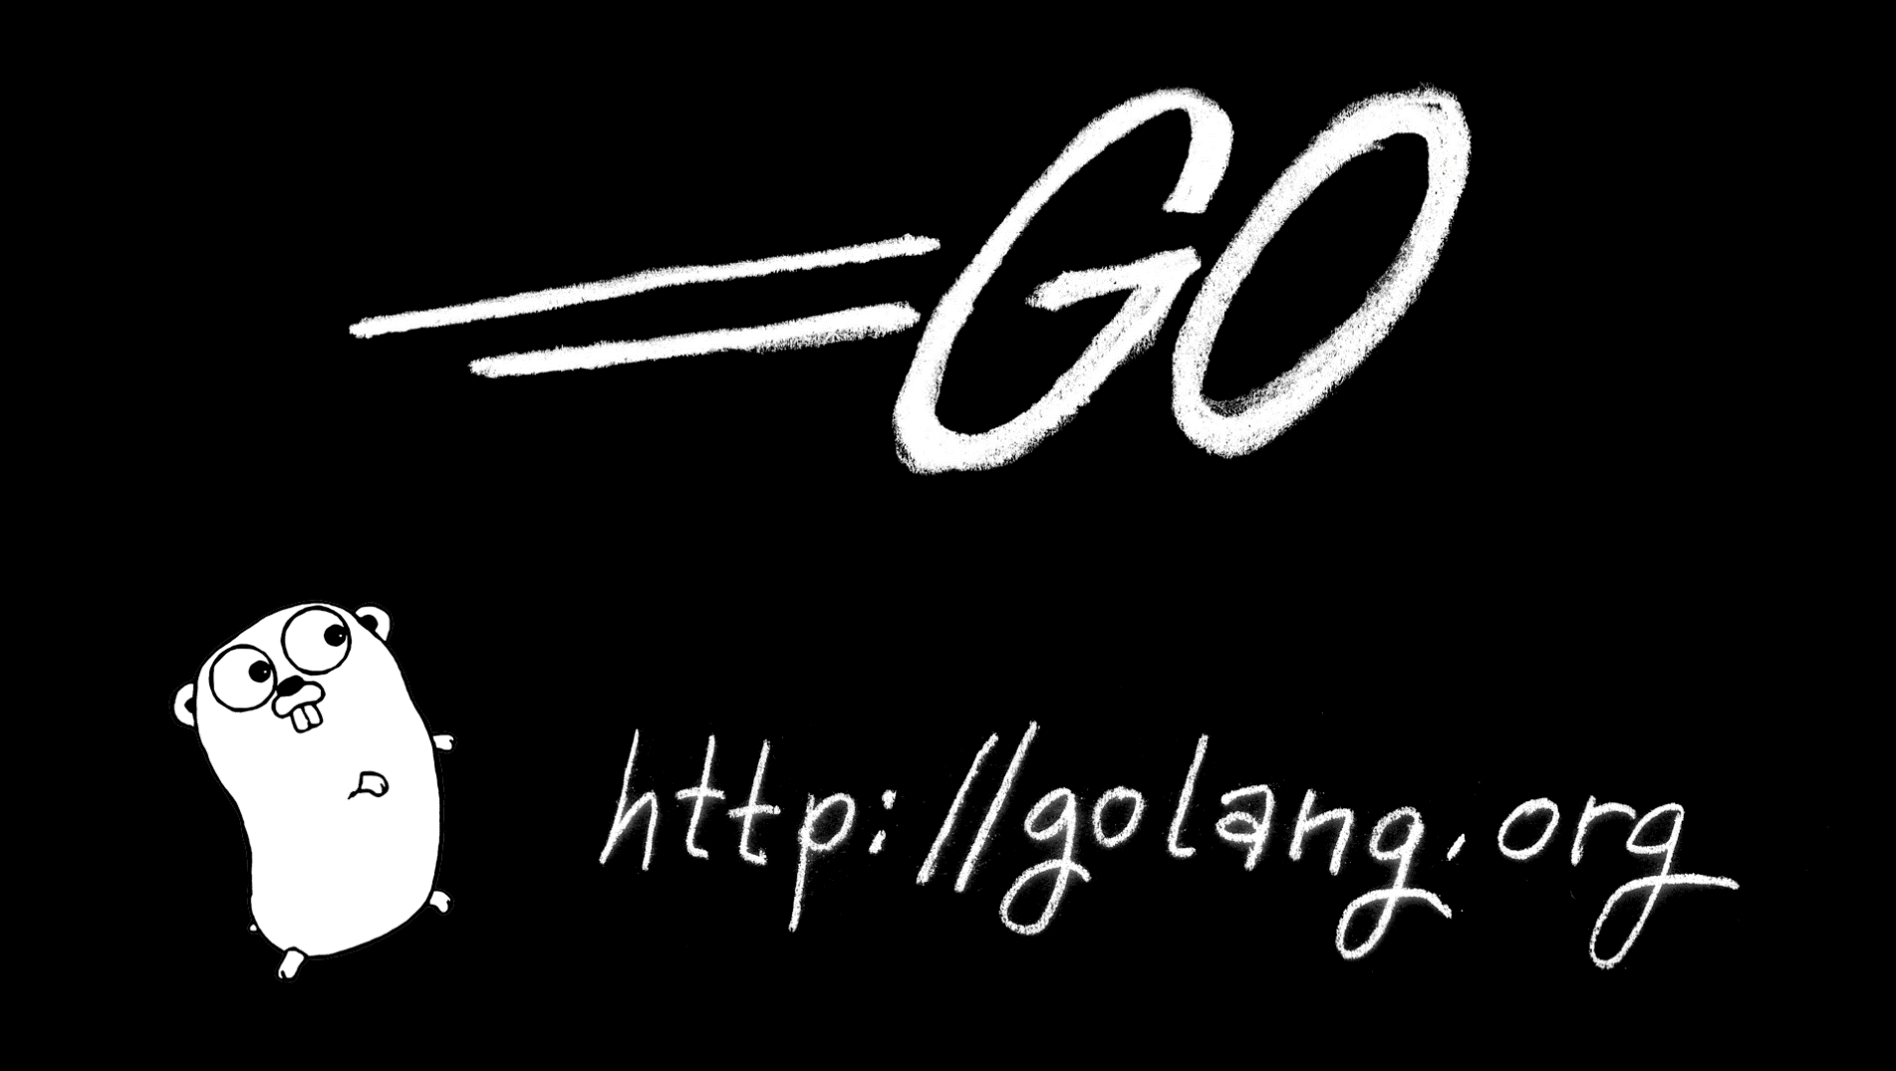

Slide 5
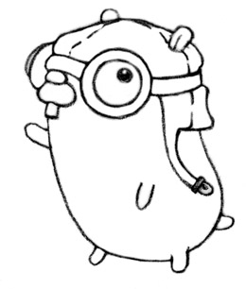
GoLang Philly @DramaFever 1717 Arch Street 2nd Tuesday Of The Month
monthly meetup

Slide 6
compiled, garbage-collected, statically linked, concurrent programming language

Slide 7
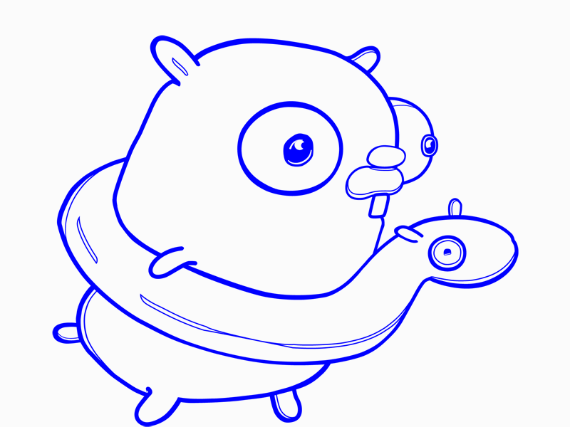
fun

Slide 8
design goals
Build fast.
Sane dependency management.
Scale.
Roughly C-like syntax.
Make software engineering better.
Solve “Google-sized” problems.

Slide 9
object model
Go is object oriented without a lot of the complexity found in C++/Java/C#:
No inheritance. Composition instead.
No interface implementation. Duck typing instead.
No constructors. Factories instead.
Polymorphism through interfaces.

Slide 10
Let’s Code!

Slide 11

concurrency
Accomplished via goroutines.

Slide 12
goroutines
Functions running concurrently.
Small auto-sizing stack (4K).
Cheap and scalable. Easily spawn 100,000+.
Compose to larger concepts.

Slide 13
goroutines
1
2
3
4
5
6
7
8
9
10
11
12
13
package main
import ("fmt"; "time")
func main() {
lazy()
fmt.Println("A")
}
func lazy(thing int) {
time.Sleep(1 * time.Second)
fmt.Println("B")
}

Slide 14
goroutines
1
2
3
4
5
6
7
8
9
10
11
12
13
package main
import ("fmt"; "time")
func main() {
go lazy()
fmt.Println("A")
}
func lazy(thing int) {
time.Sleep(1 * time.Second)
fmt.Println("B")
}
create a goroutine by invoking a function prefixed with the keyword go.

Slide 15
channels
Strongly typed message queues used to communicate and synchronize between goroutines.
Easier Than Primitives locks, semaphores, critical sections, threads
Fun
First Class Citizen

Slide 16
channels
Communication and synchronization between goroutines.
synchronization
receiver
sender

Slide 17
channels
c := make(chan int)
synchronization
receiver
sender

Slide 18
channels
c := make(chan int)
synchronization
goroutine A
receiver
c <- 15

Slide 19
channels
c := make(chan int)
synchronization
goroutine B
goroutine A
x := <-c
c <- 15
both sides block until both are ready

Slide 20
channels
c := make(chan int, 3)
can specify buffer slots (defaults to 0)
buffer slots
goroutine B
goroutine A
x := <-c
c <- 15
… unless there is a free buffer slot

Slide 21
Let’s Code!

